Slide 1
CODING WITH LIBRARIES → imaging (10 Feb)
Leandri Kleyn
Niel de Waal

Slide 2
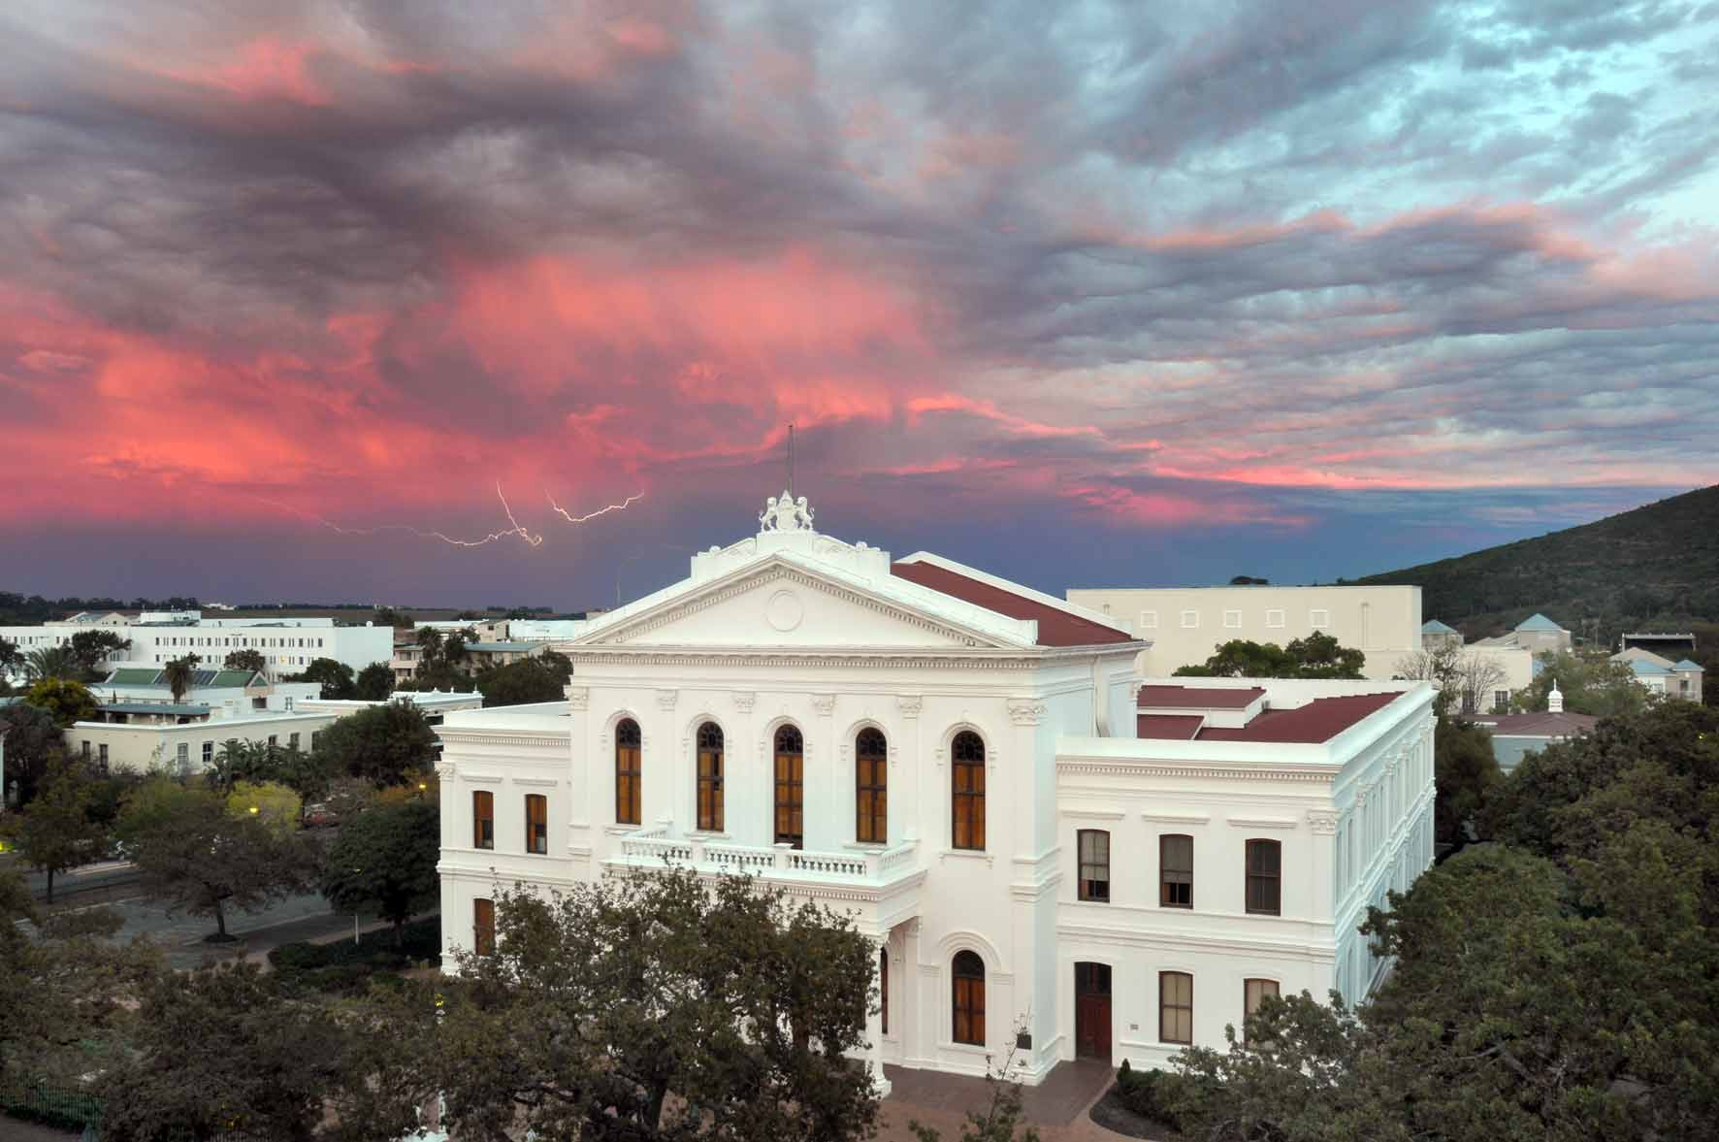
Starting with Imaging
import Image
im = Image.open('weerlig.jpg')
im.show()

Slide 3
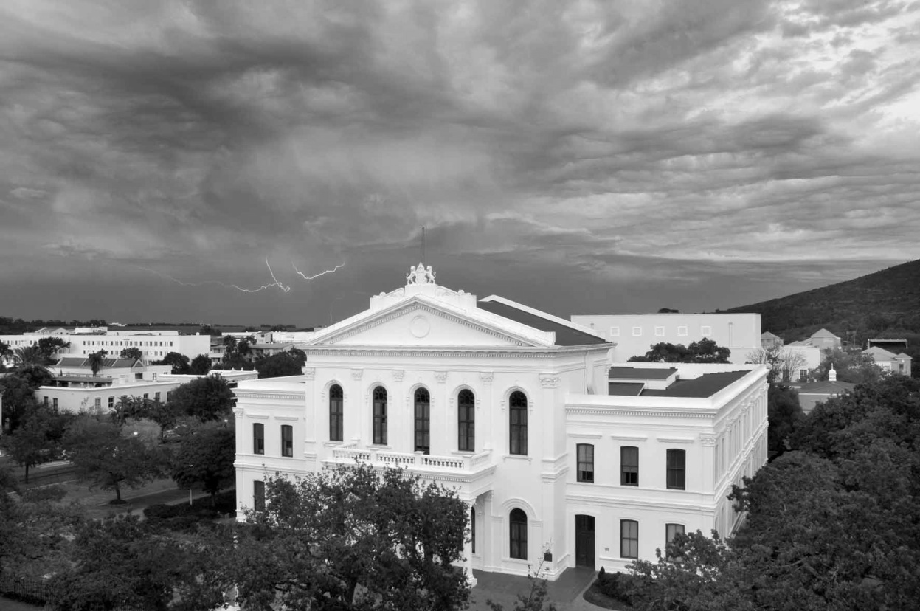
Black and White
im = Image.open('weerlig.jpg').convert(“L”)
To convert to color use “RGB” instead of “L”

Slide 4
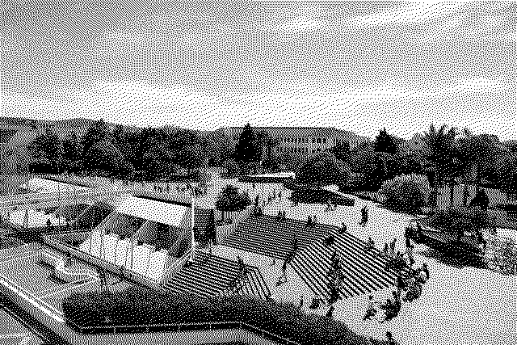
Grey with spots
im = Image.open('bib.jpg').convert("1")

Slide 5
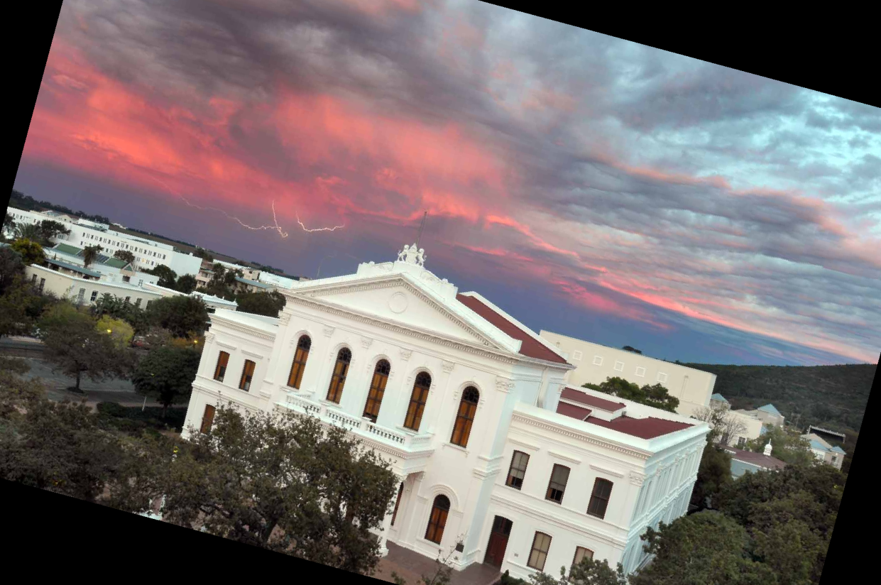
Rotation
im = im.rotate(-15)

Slide 6
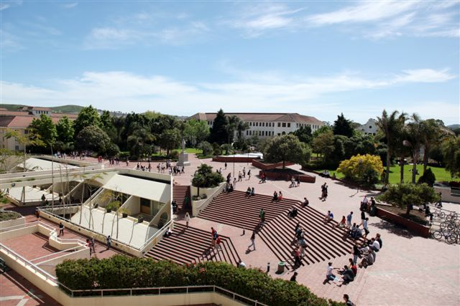
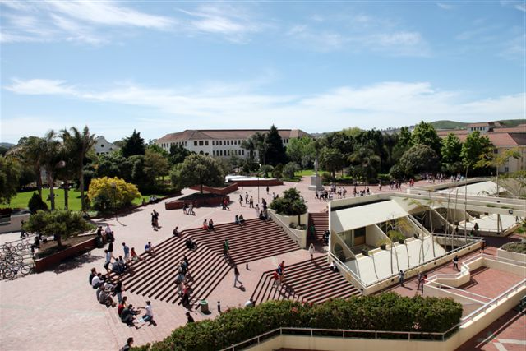
Transpose
flip = im.transpose(Image.FLIP_LEFT_RIGHT)

Slide 7
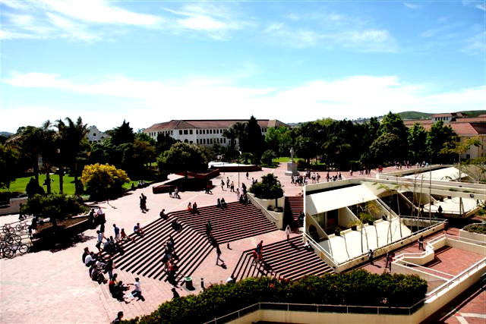
Enhancing/Contrast
enhancing = ImageEnhance.Contrast(flip)
enhancing.enhance(1.5).show()

Slide 8
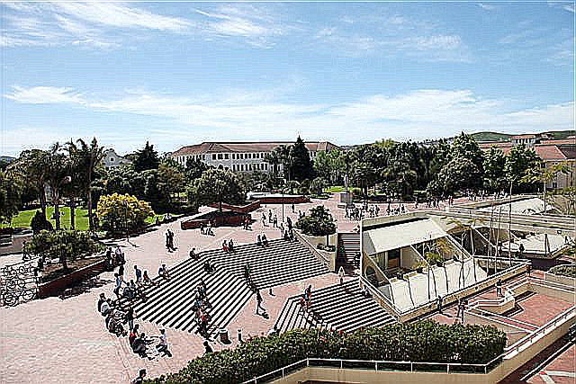
Enhancing/Sharpness
enh = ImageEnhance.Sharpness(image)
enh.enhance(10).show()

Slide 9
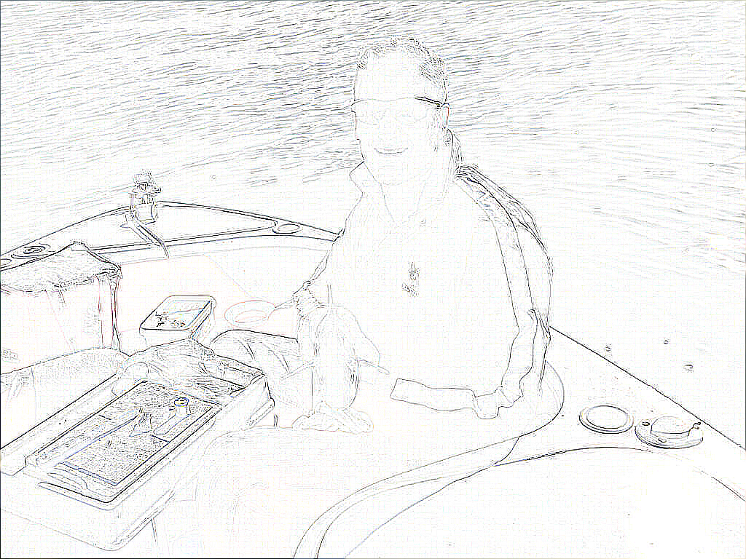
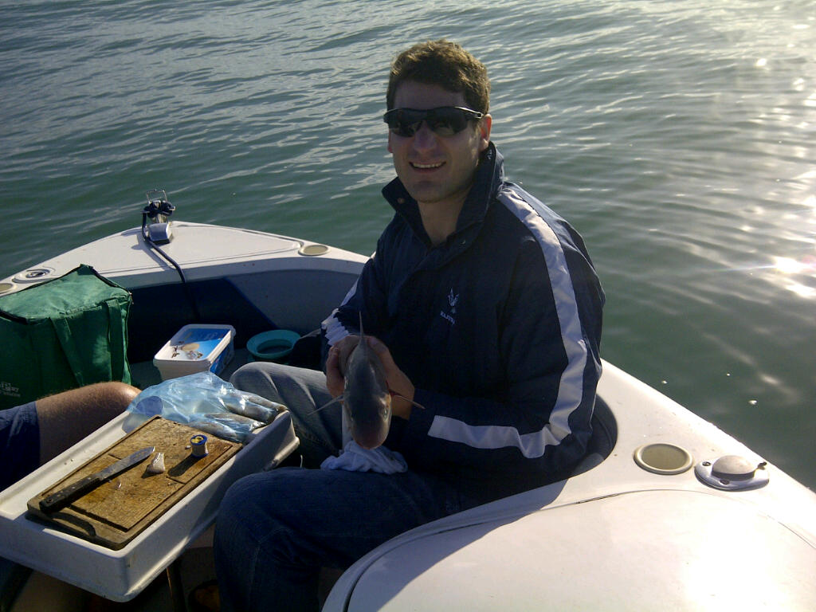
ImageFilter
import ImageFilter
imout = im.filter(ImageFilter.CONTOUR)
imout.show()

Slide 10
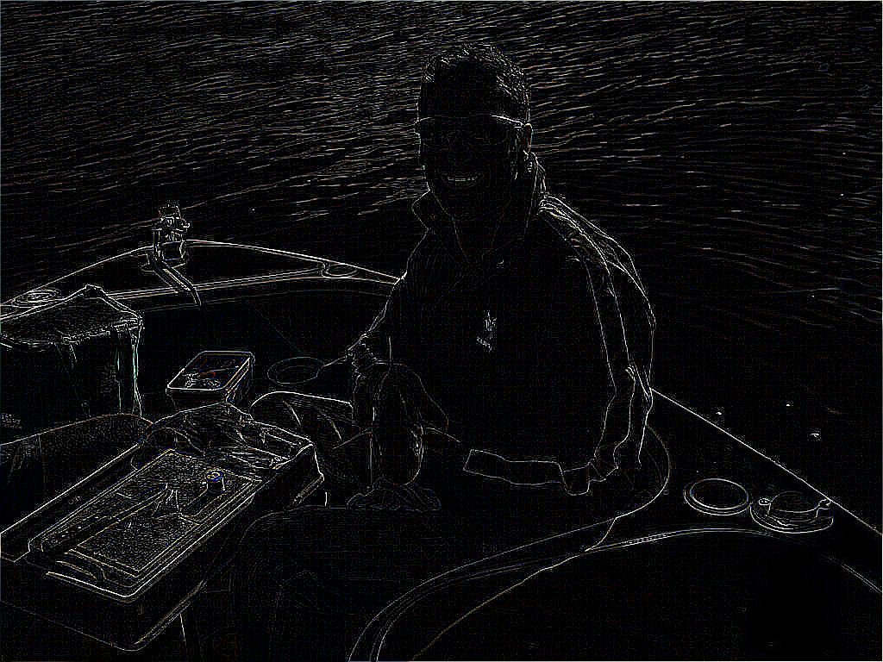
ImageFilter
imout = im.filter(ImageFilter.FIND_EDGES)
imout.show()

Slide 11
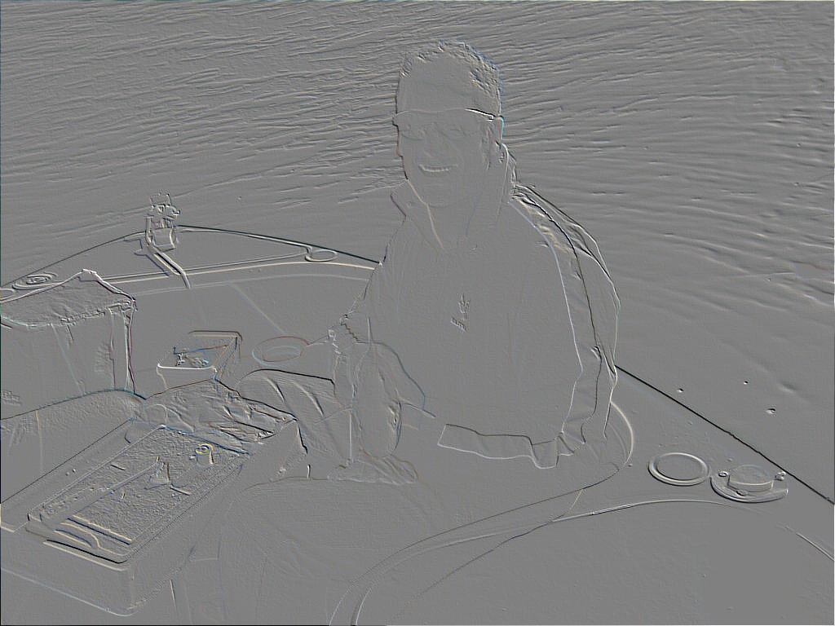
ImageFilter
imout = im.filter(ImageFilter.EMBOSS)
imout.show()

Slide 12
Other filters
BLUR, CONTOUR, DETAIL, EDGE_ENHANCE, EDGE_ENHANCE_MORE, EMBOSS, FIND_EDGES, SMOOTH, SMOOTH_MORE, and SHARPEN

Slide 13
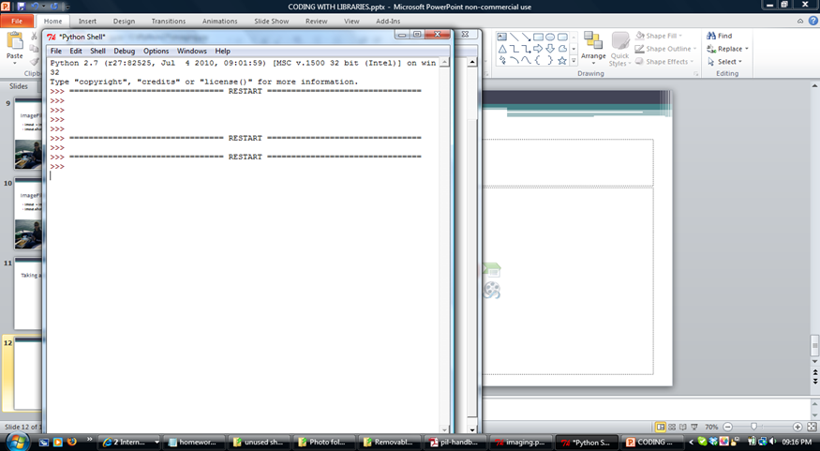
Taking a Screenshot
import ImageGrab
n = ImageGrab.grab()
n.show()

Slide 14



The draw function
import ImageDraw
im = Image.open("images.jpg")
draw = ImageDraw.Draw(im)
draw.line((0, 0) + im.size, fill=128)
draw.line((0, im.size[1], im.size[0], 0), fill=128)
draw.rectangle((10,im.size[1]-10,400,im.size[0]),fill=40)

Slide 15
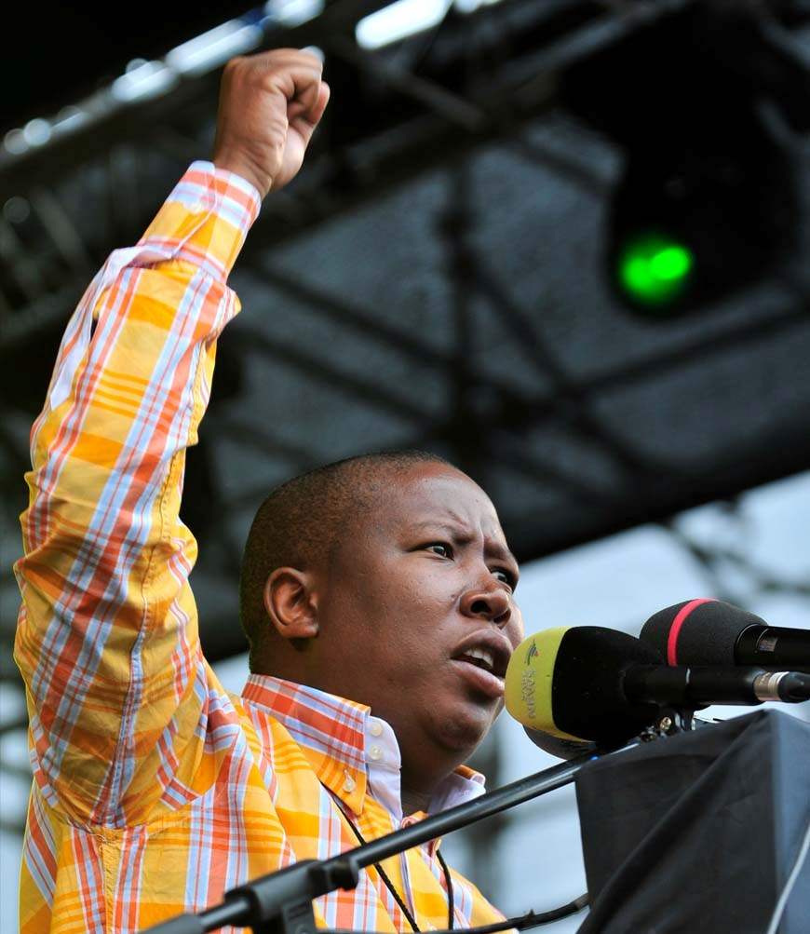
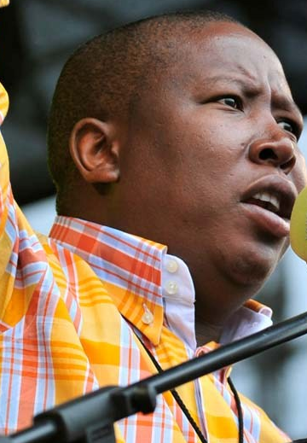
Crop an image (eg an profile ‘photo’)
im = Image.open("malema.jpg")
im.crop((350,350,700,700)).show()

Slide 16
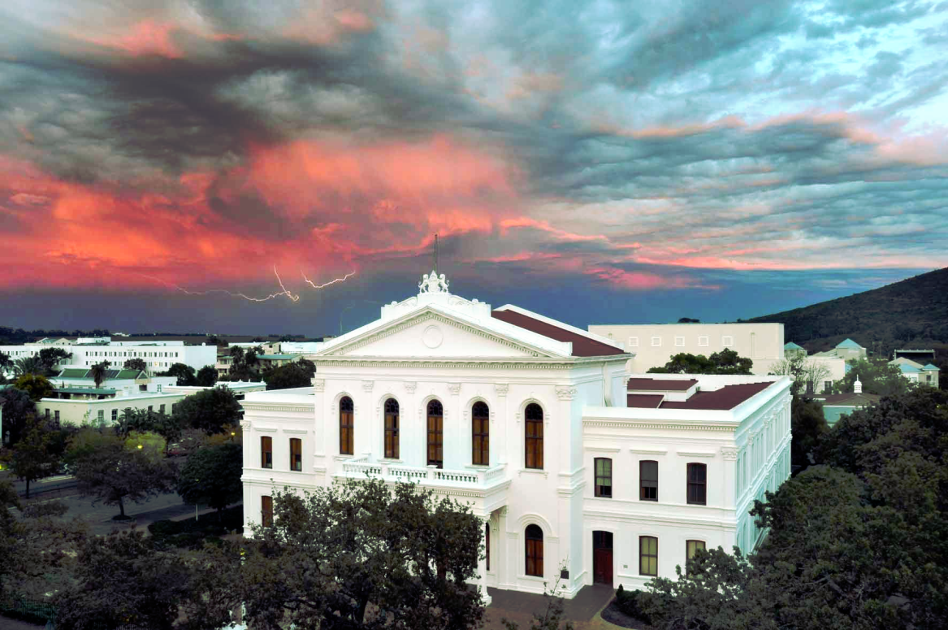
Equalize
import ImageOps
imag = Image.open("weerlig.jpg")
n = ImageOps.equalize(imag)
Equalize the image histogram. This function applies a non-linear mapping to the input image, in order to create a uniform distribution of grayscale values in the output image.

